Slide 1
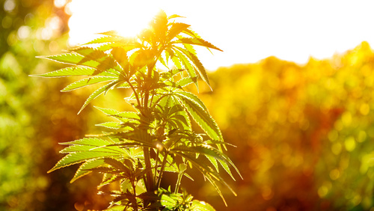
Cannabis Use in Adolescents and Young Adults: The Who, What, and How
Thomas E. Freese, Ph.D.
Co-Director, UCLA Integrated Substance Abuse Programs
Co-Director, Pacific Southwest Addiction Technology Transfer Center
tfreese@mednet.ucla.edu
www.uclaisap.org www.psattc.org
Notes:
Foltolia image to purchase: File: #165403098
The purpose of this half-day, introductory training is to provide HIV clinicians (including, but not limited to physicians, dentists, nurses, and other allied medical staff, therapists and social workers, and counselors, specialists, and case managers) with an overview of marijuana, the changing recreational and medical landscape, its use among individuals living with HIV, and strategies on how to work with patients who are using marijuana for either recreational and/or medical reasons.
“Test your Knowledge” questions have been inserted at the beginning and end of the presentation to gauge training participants’ experience and knowledge about medical marijuana, and assess change in the audience’s level knowledge after the key content has been presented. An answer key is provided in the Trainer’s notes for slides x-x and slides x-x.
Audience Response System can be utilized, if available, when facilitating the Test Your Knowledge question sessions.
In addition, discussion activities have been inserted in the presentation (slide x, slide x, slide x, and slides x-x) to encourage dialogue among the training participants, and to illustrate how the information contained within the presentation can be used in clinical practice.

Slide 2
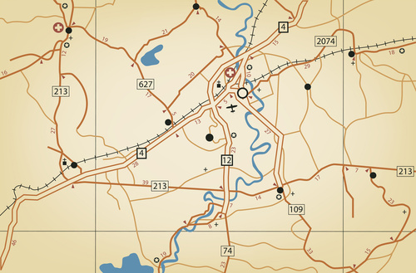
Training Roadmap
Who is using cannabis?
What is cannabis?
How is cannabis used?
Notes:
UPDATE
Part 1 of the training will provide an overview of marijuana, how it works, who tends to use it, and its effects. Part 2 of the training will focus on the use of marijuana as a medicine and the legal questions surrounding medical marijuana. Part 3 of the training will focus on medical marijuana and use among people living with HIV. Finally, Part 4 of the training will focus on strategies that HIV providers can use when working with patients who are either using medical marijuana or considering using medical marijuana. Highlight that there is no clear “right” or “wrong” answer when it comes to medical marijuana use by people living with HIV, so providers should be able to share the facts with patients, and help them make informed decisions regarding medical marijuana in order to improve their overall health and well-being.
What is it and who’s using it

Slide 3


Marijuana :
What do we know?
(circa 1936)

Slide 4
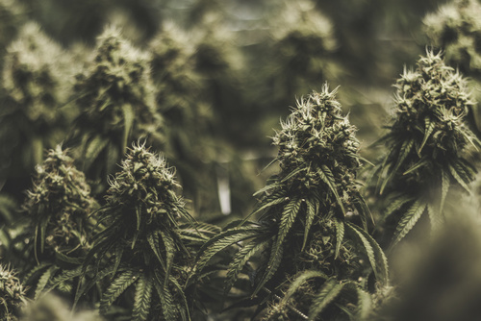
Who is Using Marijuana?
Notes:
TRANSITION SLIDE
Part 1 of the training will provide an overview of marijuana, how it works, who tends to use it, and its effects.
Fotolia image to purchase: File: #138485966

Slide 5
Marijuana Use is Common
Marijuana is the most commonly used illicit drug in the U.S. (and the world)
Any use among general population age 12+ in past month:
  2016: 9%
  2008: 5.8%
Use is most common among people age 18-25 (19% of population)
48% of adults in the US report having used marijuana at some time in their life
SOURCES: SAMHSA 2017; Pew Charitable Trust, 2013.
Notes:
Marijuana is the most commonly used illicit drug (rates of alcohol use are higher). The rate of current use (i.e., use in past month) has been increasing in recent years, from 5.8% in 2008 to 7% in 2011 of the general population aged 12 or older. It is most commonly used by young adults age 18-25; almost one-fifth of the population in this age group uses marijuana.
Additional Information for the Trainer(s)
Because of its increased prevalence, many people have either tried marijuana themselves or know of a friend or loved one who has tried the drug. As a result, public attitudes towards the drug have shifted in recent years. In 1990, only 16% of Americans favored the legalization of marijuana, and 81% wanted it to remain illegal. By 2013, 52% favored legalization, and just 45% want it to remain illegal. Young people are the most supportive of marijuana legalization. Sixty-five percent (65%) of Millennials – people who are now between the ages of 18 and 32 – favor legalizing the use of marijuana, up from just 36% in 2008. Yet, there also has been a striking change in long-term attitudes among older generations, particularly Baby Boomers. This change in attitudes is most likely driven by changes in the perception of harm or risk associated with marijuana use.
Among youth who first tried marijuana in the past year, the average age was 16.2 years old. This is important because the earlier people begin using marijuana, the more likely they are to become dependent later, and also experience negative effects on cognitive functioning, educational attainment, and income as adults, and they are more likely to develop mental disorders. Nevertheless, this relationship is one of correlation, so it does not prove causation. That is, youth with poorer cognitive skills may seek out marijuana use, and other factors (e.g., risk taking propensity, lower socioeconomic status, and exposure to childhood trauma or other environmental risks) may also underlie poorer educational attainment. Some longitudinal research has been performed, however, showing that people who started smoking marijuana as teenagers and used it heavily for decades lost IQ points over time, while those who started smoking as adults did not.
REFERENCES (refer to reference list for full citations):
SAMHSA, 2017.
Pew Charitable Trust, 2013.

Slide 6
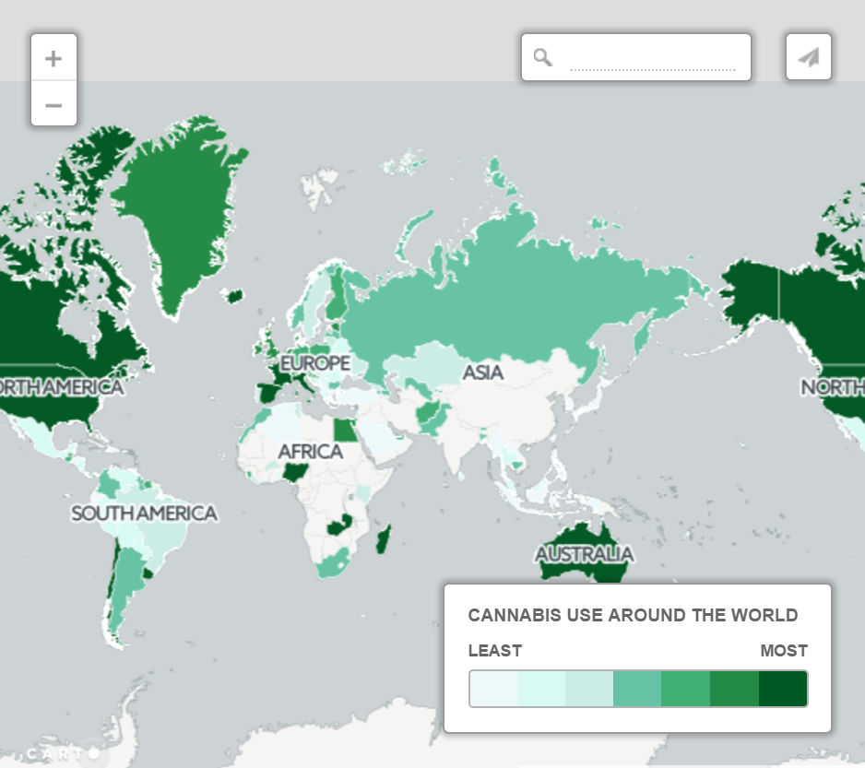

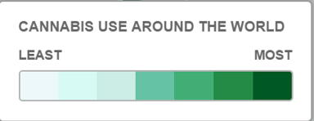
http://www.telegraph.co.uk/travel/maps-and-graphics/mapped-the-countries-that-smoke-the-most-cannabis/

Slide 7
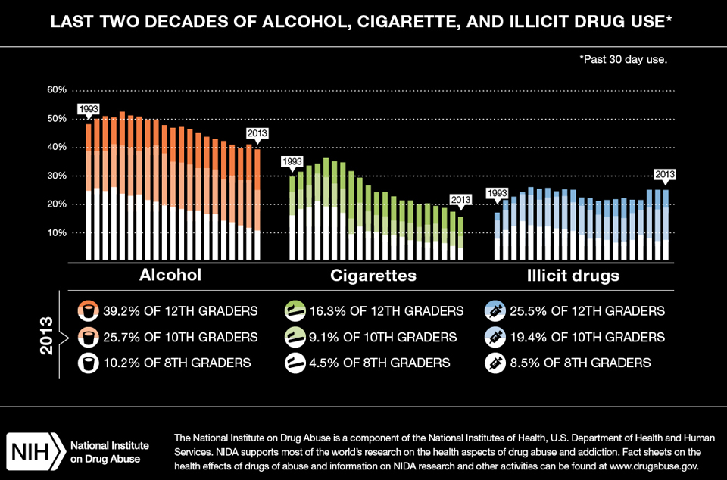
Monitoring the Future 2013

Slide 8
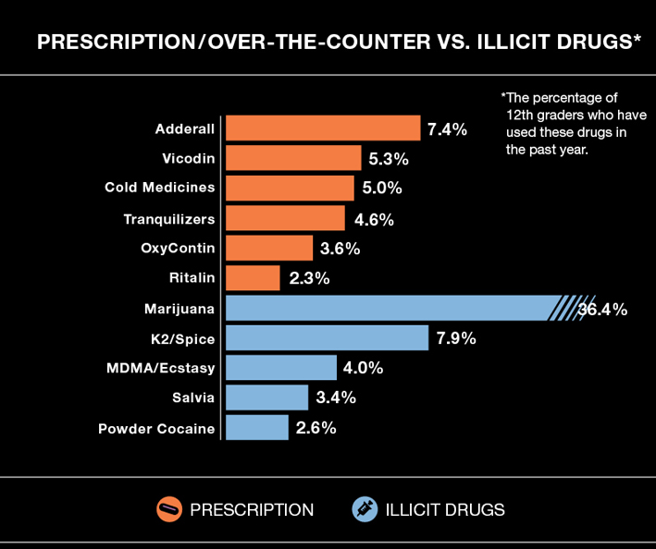
Monitoring the Future 2013

Slide 9
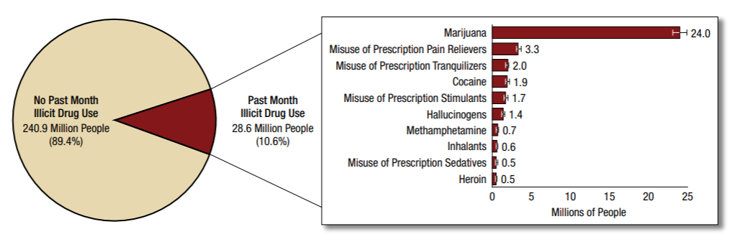
Marijuana is the #1 Illicit Drug Used in the U.S. among People 12 and Older
The number of past month marijuana users corresponds to 8.9% of the
US population aged 12 and older
SOURCE: SAMHSA, NSDUH, 2016 findings.
Notes:
NSDUH obtains information on 10 categories of illicit drugs: marijuana, cocaine (including crack), heroin, hallucinogens, inhalants, and methamphetamine, as well as the misuse of prescription pain relievers, tranquilizers, stimulants, and sedatives; see the section on the misuse of psychotherapeutic drugs for the definition of misuse. Estimates of “illicit drug use” reported from NSDUH reflect the data from these 10 drug categories. Because of changes in measurement in 2015 for 7 of the 10 illicit drug categories— hallucinogens, inhalants, methamphetamine, and the misuse of prescription pain relievers, tranquilizers, stimulants, and sedatives—estimates of use of any illicit drug and these 7 illicit drug categories in 2016 are not comparable with estimates prior to 2015.
In 2016, an estimated 28.6 million Americans aged 12 or older were current (past month) illicit drug users, meaning that they had used an illicit drug during the month prior to the survey interview . The most commonly used illicit drug in the past month was marijuana, which was used by 24.0 million people aged 12 or older. An estimated 6.2 million people reported misusing psychotherapeutic drugs at least once in the past month, including 3.3 million people who were misusers of prescription pain relievers. Thus, the number of current misusers of pain relievers was second to marijuana among specific illicit drugs. Smaller numbers of people in 2016 were current users of the other illicit drugs.
The number of current marijuana users was higher in 2016 than it was between 2002 and 2015. The increase in marijuana reflects an increase in use by adults aged 26 and older, and, to a lesser extent, an increase among those age 18-25.
REFERENCE:
NSDUH citation

Slide 10
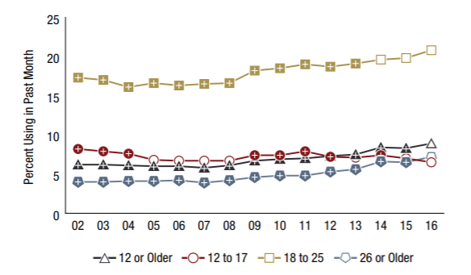
Age Breakdown of Current Marijuana Users among People 12 and Older, 2016
SOURCE: SAMHSA, NSDUH, 2016 findings.
Notes:
Aged 12 to 17
In 2016, 6.5 percent of adolescents aged 12 to 17 were current users of marijuana (Figure 17). This means that approximately 1.6 million adolescents used marijuana in the past month. The percentage of adolescents in 2016 who were current marijuana users was lower than the percentages in most years from 2009 to 2014, but it was similar to the percentage in 2015.
Aged 18 to 25
In 2016, about 1 in 5 young adults aged 18 to 25 (20.8 percent) were current users of marijuana (Figure 17). This means that 7.2 million young adults used marijuana in the past month. The percentage of young adults who were current marijuana users in 2016 was higher than the percentages between 2002 and 2013, but it was similar to the percentages in 2014 and 2015.
Aged 26 or Older
In 2016, 7.2 percent of adults aged 26 or older were current users of marijuana (Figure 17), which represents about 15.2 million adults in this age group. The percentage of adults aged 26 or older who were current marijuana users in 2016 was higher than the percentages in 2002 to 2015.

Slide 11
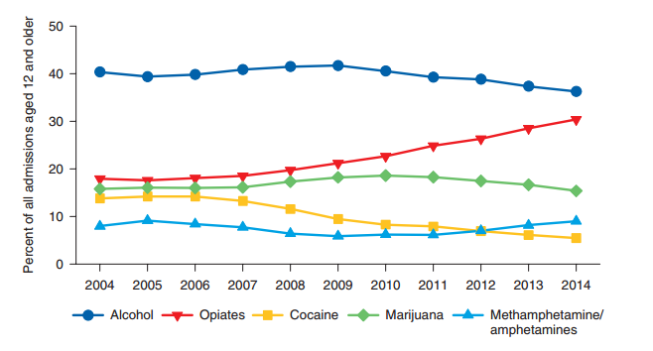
Primary Substance of Abuse at Admission: 2004-2014
SOURCE: SAMHSA, Treatment Episode Data Set, 2014 results.
Notes:
According to SAMHSA’s Treatment Episode Data Set, the proportion of cocaine admissions has been on the decline, from 14% of admissions aged 12 and older in 2004 to 5% in 2014. Smoked cocaine (crack) represented 72% of all primary cocaine admissions in 2004; it was 66% in 2014. The proportion of stimulant admissions aged 12 and older (98 to 99% of these admissions were for methamphetamine or amphetamine abuse) ranged from 6% to 9% of admissions aged 12 and older between 2004 and 2014.
Additional Information for the Trainer(s):
Fifty-nine percent (59%) of primary smoked cocaine admissions and 69% of primary non-smoked cocaine admissions were male. The average age at admission among primary smoked cocaine admissions was 44 years; among primary non-smoked cocaine admissions, the average age was 38 years. Among primary smoked cocaine admissions, 56% were non-Hispanic Black, 32% were non-Hispanic White, and 8% were of Hispanic origin. Among primary non-smoked cocaine admissions, 43% were non-Hispanic White, 34% were non-Hispanic Black, and 19% were of Hispanic origin. Seventy-nine percent (79%) of primary non-smoked cocaine admissions reported inhalation as their route of administration, and 11% reported injection.
Fifty-four percent (54%) of primary methamphetamine/amphetamine admissions were male. For primary methamphetamine/amphetamine admissions, the average age at admission was 33 years. About two-thirds (67%) of primary methamphetamine/amphetamine admissions were non-Hispanic White, 18% were of Hispanic origin, and 4% were non-Hispanic Blacks. Sixty-one percent (61%) of primary methamphetamine/amphetamine admissions reported smoking as the usual route of administration, 26% reported injection, and 8% reported inhalation.
REFERENCE:
Substance Abuse and Mental Health Services Administration, Center for Behavioral Health Statistics and Quality. (2016). Treatment Episode Data Set (TEDS): 2004-2014. National Admissions to Substance Abuse Treatment Services. BHSIS Series S-84, HHS Publication No. (SMA) 16-4986. Rockville, MD: Author.

Slide 12
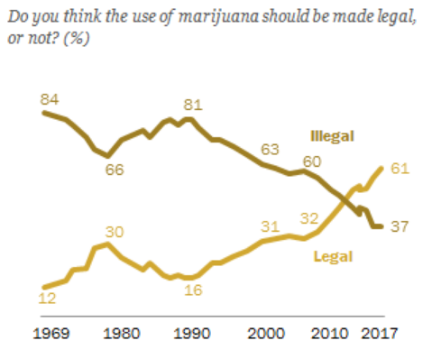
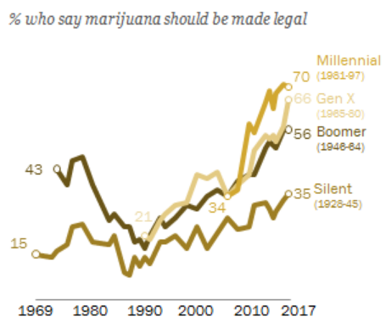
Public Opinion on Legalizing Marijuana
1969-2017
In 2017, about six in ten Americans said the use of marijuana should be legalized
SOURCE: Pew Research Center, 2017.
Notes:
The survey was conducted by Pew Research Center in October 2017. In just one year, from 2016 to 2017, the percentage of Americans who said the use of marijuana should be legalized rose from 57% to 61%. This was nearly double what was said in the year 2000 (31%).
Note: “Don’t Know” responses are not shown in the graphs. 1973-2008 data from General Social Survey; 1969 and 1972 data from Gallup. SOURCE: Survey of U.S. adults conducted October 25-30, 2017.
REFERENCE:
Pew Research Center. (2017). About six-in-ten Americans support marijuana legalization. Retrieved from http://www.pewresearch.org/fact-tank/2018/01/05/americans-support-marijuana-legalization/ 2018 May 16.

Slide 13
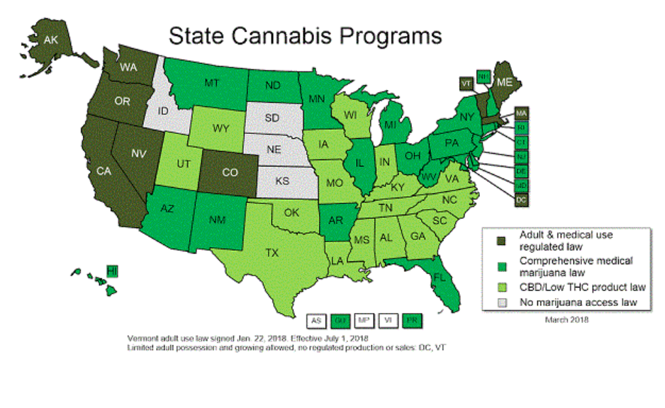
Recreational and Medical Use of Cannabis in the U.S.
SOURCE: National Conference of State Legislatures website, 2018.
Notes:
In 1996, California voters passed Proposition 215, making the Golden State the first in the union to allow for the medical use of marijuana. Since then, 29 more states, the District of Columbia, Guam and Puerto Rico have enacted similar laws. As of Jan. 22, 2018, the Vermont legislature passed adult-use legalization legislation and the governor signed the bill. The measure does NOT set up a regulatory for system for sales or production. See text of measure below.
A total of 30 states, the District of Columbia, Guam and Puerto Rico now allow for comprehensive public medical marijuana and cannabis programs. Approved efforts in 16 states allow use of "low THC, high cannabidiol (CBD)" products for medical reasons in limited situations or as a legal defense. Those programs are not counted as comprehensive medical marijuana programs . NCSL uses criteria similar to other organizations to determine if a program is "comprehensive":
Protection from criminal penalties for using marijuana for a medical purpose;
Access to marijuana through home cultivation, dispensaries or some other system that is likely to be implemented;
It allows a variety of strains, including those more than "low THC;" and
It allows either smoking or vaporization of some kind of marijuana products, plant material or extract.
Twenty-two states and the District of Columbia have decriminalized small amounts of marijuana. Eight of those states and the District of Columbia have legalized small amounts of marijuana for adult recreational use.
REFERENCE:
National Conference of State Legislatures website, 2018, http://www.ncsl.org/.

Slide 14
Why Do People Use Marijuana?
Among people who used marijuana in the past year:
SOURCE: Pew Charitable Trust, 2013.
Notes:
This chart highlights the findings from a study released in 2013 in which 47% of respondents who used marijuana in the past year reported using it just for fun, 30% reported using it for medical reasons, and 23% reported using it for fun and medical reasons. In other words, over half of the respondents who used marijuana in the past year used it at least in part for medical reasons.
REFERENCE:
Pew Charitable Trust Foundation. (2013). Who’s Used Marijuana and Why?

Slide 15
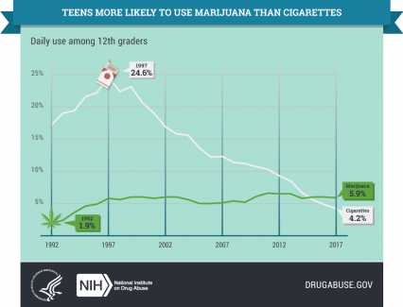
Marijuana is Now More Common than
Cigarettes among High School Seniors
24.6%
5.9%
1.9%
4.2%
SOURCE: NIDA, MTF 2017 Results.
Notes:
According to the findings from the 2017 Monitoring the Future Survey, daily marijuana use exceeds daily cigarette use among 8th, 10th, and 12th graders. This year is the first in which daily marijuana use outpaced daily cigarette use. This reflects a steep decline in daily cigarette use and a fairly stable trend in daily marijuana use. The graph included here just includes data for 12th graders.
REFERENCE:
National Institute on Drug Abuse. (2017). Monitoring the Future Survey: High School and Youth Trends. Retrieved from NIDA. (2017, December 14). Monitoring the Future Survey: High School and Youth Trends. Retrieved from https://www.drugabuse.gov/publications/drugfacts/monitoring-future-survey-high-school-youth-trends on 2018, May 16.

Slide 16

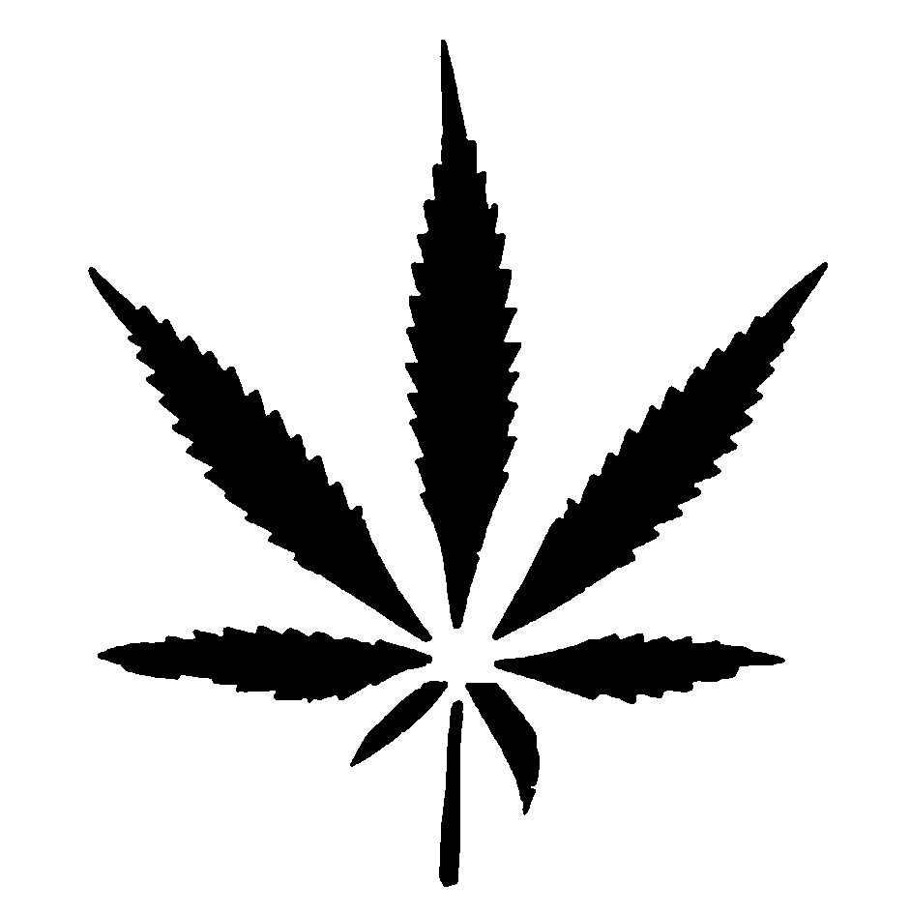


Perceived Cannabis Harm and Use among Middle and High School Students
Using
Perceived Harm
64.5%
14.7%
12.7%
41.5%
2007
2017
As perceived harm drops, use INCREASES
SOURCE: NIDA, MTF, 2017 results.
Notes:
Past 30-day use (8th, 10th, 12th graders)
Harm of using marijuana regularly (8th, 10th, 12th graders)

Slide 17
Is Marijuana Use Associated with an Increased Risk of Opioid Misuse?
Based on data from the National Epidemiologic Survey on Alcohol and Related Conditions
Respondents who reported past-year marijuana use had 2.2 x higher odds than non-users of meeting diagnostic criteria for a prescription opioid use disorder by follow-up
  Also had 2.6 x greater odds of initiating prescription opioid misuse
SOURCE: Olfson et al., 2017.
Notes:
Look at NIDA_MJ_Rx_Opioid_Use_Risk article for more notes.
This study focused on individual marijuana users vs. non-users and their trajectories with regard to opioid misuse and disorders. The findings are in line with previous research demonstrating that people who use marijuana are more likely than non-users to use other drugs and develop problems with drug use.
A number of recent papers suggest that marijuana may reduce prescription opioid addiction and overdoses by providing an alternative or complementary pain relief option. That suggestion is partly based on comparisons of aggregate data from states that legalized marijuana for medical use vs. those that did not.
REFERENCE:
Olfson, M., Wall, M.W., Liu, S-M, & Blancos, C. (2017). Cannabis use and risk of prescription opioid use disorder in the United States. American Journal of Psychiatry, 175(1), 47-53.

Slide 18
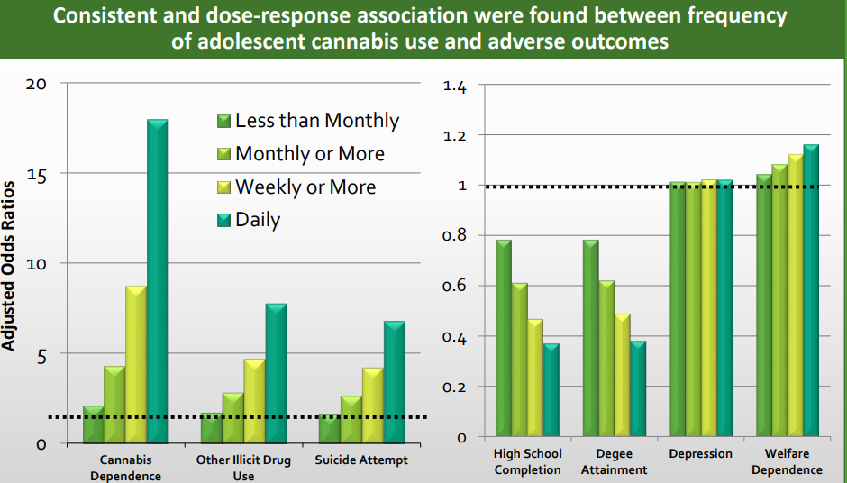
Frequency of Use during Teen Years and Adverse Outcomes
SOURCE: Dr. Susan Weiss, NIDA, August 2017 National Cannabis Summit Keynote, Denver, CO.
Notes:
Findings
We recorded clear and consistent associations and dose-response relations between the frequency of adolescent cannabis use and all adverse young adult outcomes. After covariate adjustment, compared with individuals who had never used cannabis, those who were daily users before age 17 years had clear reductions in the odds of high-school completion (adjusted odds ratio 0·37, 95% CI 0·20–0·66) and degree attainment (0·38, 0·22–0·66), and substantially increased odds of later cannabis dependence (17·95, 9·44–34·12), use of other illicit drugs (7·80, 4·46–13·63), and suicide attempt (6·83, 2·04–22·90).
Interpretation
Adverse sequelae of adolescent cannabis use are wide ranging and extend into young adulthood. Prevention or delay of cannabis use in adolescence is likely to have broad health and social benefits. Efforts to reform cannabis legislation should be carefully assessed to ensure they reduce adolescent cannabis use and prevent potentially adverse developmental effects.
REFERENCE:
Sillins, E., Horwood, L.J., Patton, G.C., et al. (2014). Young adult sequelae of adolescent cannabis use: An integrative analysis. The Lancet Psychiatry, 1(4), 286-293.

Slide 19
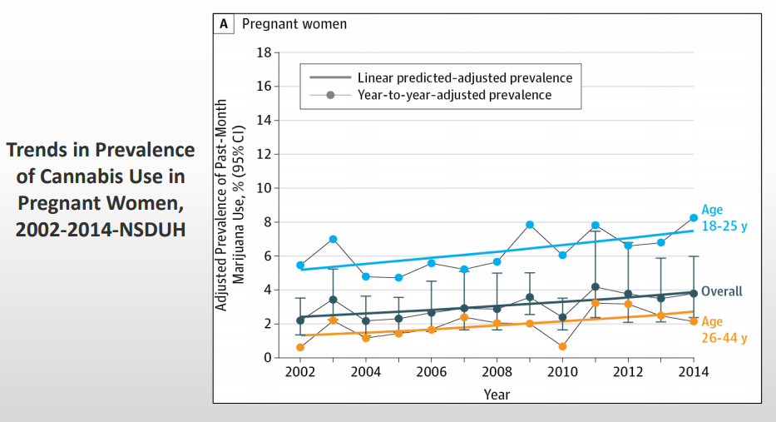
Cannabis Use during
Pregnancy is Increasing
SOURCE: Dr. Susan Weiss, NIDA, August 2017 National Cannabis Summit Keynote, Denver, CO.
Notes:
Slide courtesy of Dr. Susan Weiss, NIDA (2017 NCS Plenary).
Original source: Brown et al., 2017.

Slide 20
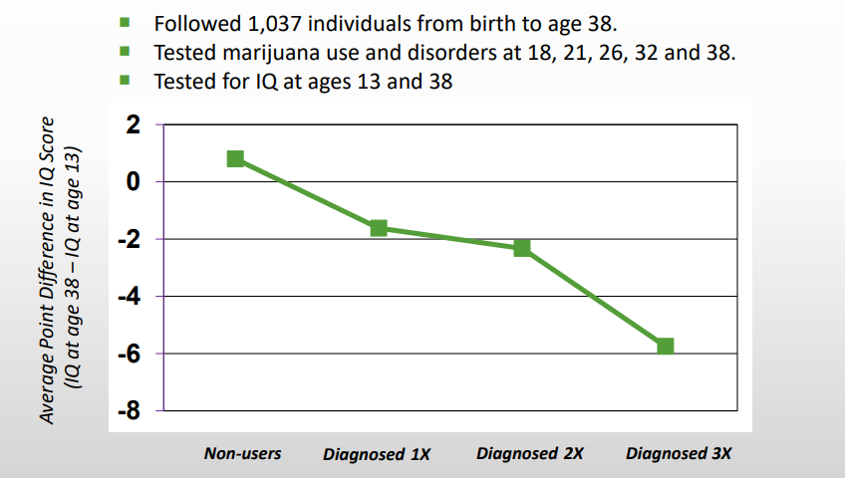
Impact on Cognition – Significant IQ Drop between Childhood and Mid-Life
SOURCE: Dr. Susan Weiss, NIDA, August 2017 National Cannabis Summit Keynote, Denver, CO;
Meier et al., 2012
Notes:
Slide adapted from Dr. Susan Weiss, NIDA (2017 NCS Plenary).
REFERENCE:
Meier, M.H., Caspi, A., Ambler, A., et al. (2012). Persistent cannabis users show neuropsychological decline from childhood to midlife. PNAS, 109(40), E2657-E2664.

Slide 21
What We Need to Know about Marijuana Use
Need improved measures of frequency, dosage, and use patterns
Persuasive messaging to counter trend of decreasing harm perception
Greater knowledge of changing potency, constituents, and alternate routes of admin
Regional differences based on changing laws, policies, and social norms
Impact of the use of other substances (sequentially or concurrently)
SOURCE: Dr. Susan Weiss, NIDA, August 2017 National Cannabis Summit Keynote, Denver, CO.

Slide 22
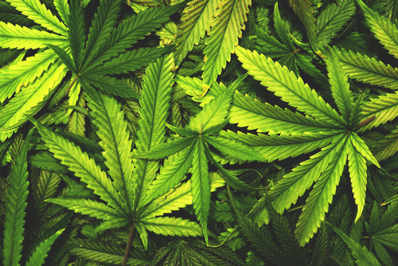
What is Marijuana and How Is It Used?
The Plant and It’s Formulations
Notes:
Fotolia image to purchase: File: #99027642

Slide 23
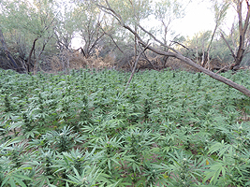
Marijuana: What is it?
Dry, shredded mix of leaves, flowers, stems, and seeds, usually from Cannabis sativa or Cannabis indica plant
Both are common subspecies of the hemp plant, which is common throughout the world
Contains over 400 chemical compounds
SOURCE: SAMHSA, 2012 (reference list).
Notes:
Marijuana is a dry shredded mixture of leaves, flower, stems, and seeds from common cannabis sativa and cannabis indica, which are two sub-species of the hemp plant. Hemp plants grow abundantly throughout the world. Marijuana gets its effects from many chemicals—it contains over 400 chemical compounds. Marijuana has many common street names—among the most widely used are “grass,” “weed,” “pot,” “reefer” “Mary Jane” and “ganja.”
Image credit: Purchased image, 2012.

Slide 24
Marijuana vs. Cannabis – is there a Preferred Term to Use?
The terms marijuana and cannabis are often used interchangeably
Under U.S. law, cannabis is the plant itself and marijuana (and hemp) are specific parts of the plant
  Hemp refers to sterilized seeds, stems, stalks, and roots
  Marijuana is in reference to the viable seeds, leaves, and flowers
Notes:
SOURCE: CBD Web (http://www.cbdweb.org/medical-cannabis-guide/hemp-vs-marijuana-vs-cannabis).
Throughout the curriculum, both terms will be used, depending on the term used in the source document.
The Controlled Substances Act (CSA) states: "The term 'marihuana' means all parts of the plant Cannabis sativa L., whether growing or not; the seeds thereof; the resin extracted from any part of such plant; and every compound, manufacture, salt, derivative, mixture, or preparation of such plant, its seeds or resin. Such term does not include the mature stalks of such plant, fiber produced from such stalks, oil or cake made from the seeds of such plant, any other compound, manufacture, salt, derivative, mixture, or preparation of such mature stalks (except the resin extracted therefrom), fiber, oil, or cake, or the sterilized seed of such plant which is incapable of germination." 21 U.S.C. § 802(16).
Marijuana is a Schedule I substance under the CSA. Schedule I drugs are classified as having a high potential for abuse, no currently accepted medical use in treatment in the United States, and a lack of accepted safety for use of the drug or other substance under medical supervision. Marinol, a synthetic version of THC, the active ingredient found in the marijuana plant, can be prescribed for the control of nausea and vomiting caused by chemotherapeutic agents used in the treatment of cancer and to stimulate appetite in AIDS patients. Marinol is a Schedule III substance under the Controlled Substances Act. Schedule III drugs are classified as having less potential for abuse than the drugs or substances in Schedules I and II, and have a currently accepted medical use in treatment in the U.S., and abuse of the drug may lead to moderate or low physical dependence or psychological dependence.

Slide 25
Glossary of Key Terms
Cannabidiol (CBD): a cannabinoid that doesn’t make people high; may be useful in reducing pain and inflammation and controlling epileptic seizures
Cannabinoid: chemical compounds that act on the neurotransmitters of the brain (e.g., THC, CBD)
Flower: The cannabis bud; female flower harvested for consumption
Pistils: Tiny hairs on the flower that are important for reproduction
Notes:
S.T.A.T.S. booklet
NIDA Drug Facts – Marijuana as a Medicine
Pistils collect pollen from males but contribute very little to the potency and taste of the flower.

Slide 26
Glossary of Key Terms, continued
Sinsemilla: marijuana with a particularly high concentration of psychoactive agents.
Stamens: male reproductive part of the plant not attractive in a crop, as female plants are most widely used
Terpenoids: flavor and aromatic compounds of cannabis
Tetrahydrocannabinol (THC): the psychoactive compound found in the cannabis plant
Trichomes: tiny crystal-like resin glands covering the flower; contain the flavor and aromatic components of cannabis as well as the cannabinoids
Notes:
S.T.A.T.S. booklet

Slide 27
Cannabis and Cannabinoids
Cannabis contains at least 546 compounds;
104 are cannabinoids
Δ⁹⁻Tetrahydrocannabinol (Δ⁹-THC)
  Major psychoactive compound
  Acts on endocannabinoid receptors
Cannabidiol (CBD)
  Major nonpsychoactive compound
  Neuroprotective and anti-inflammatory
SOURCE: NIDA, 2018.
Notes:
Cannabichromen (CBC), Δ⁸⁻Tetrahydrocannabinol (Δ⁸-THC), Cannabigerol (CBG), Tetrahydrocannabivarin (THCV)
ElSohly MA, Mehmedic Z, Foster S, Gon C, Chandra S, Church JC. Changes in Cannabis Potency over the Last Two Decades (1995-2014) - Analysis of Current Data in the United States. Biological psychiatry. 2016;79(7):613-619. doi:10.1016/j.biopsych.2016.01.004.
Devinsky O, Cilio MR, Cross H, et al. Cannabidiol: Pharmacology and potential therapeutic role in epilepsy and other neuropsychiatric disorders. Epilepsia. 2014;55(6):791-802. doi:10.1111/epi.12631.
REFERENCE:
National Institute on Drug Abuse. (2018). Marijuana. Retrieved from https://www.drugabuse.gov/publications/drugfacts/marijuana on 2018, May 18.
Image Credit: NIDA website, 2018.

Slide 28

Marijuana and the Brain
https://www.youtube.com/watch?v=oeF6rFN9org

Slide 29
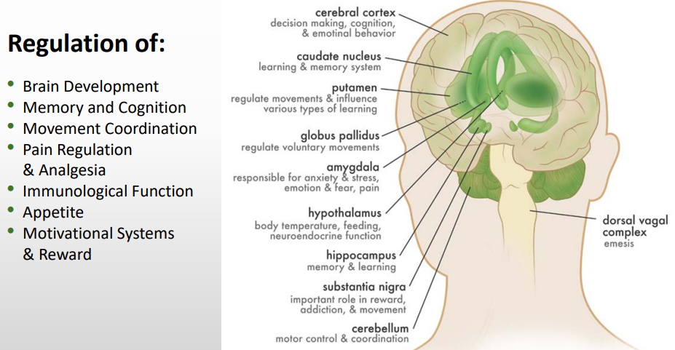
Cannabinoid Receptors are Located throughout the Brain
SOURCE: Dr. Susan Weiss, NIDA, August 2017 National Cannabis Summit Keynote, Denver, CO.
Notes:
THC works by acting on specialized cells called neurons in the brain (refer to illustration). Neurons do not touch each other, and the gap between them—called the synaptic space—needs to be bridged for messages to get from one neuron to the next. To get messages across the space, neurons release chemicals, or neurotransmitters. The receiving neuron contains special proteins called receptors that neurotransmitters will bind to, similar to the way a key fits into a lock. After a neurotransmitter has bound to a receptor, proteins called transporters or reuptake pumps will carry neurotransmitters back to the neurons that released them. The reason this process is important is that certain neurotransmitters and receptors are associated with specific emotional and functions. Any changes to these steps—the way neurotransmitters are released, the way receptors work, or the way transporters or reuptake pumps work—can have profound effects on sensation, perception, thought, mood, and behavior. When people take drugs, these processes are altered, leading to changes in the way they feel and behave. Marijuana gets its effects because it contains over 60 chemicals called cannabinoids. The main active chemical is a cannabinoid called delta-9-tetrahydorocannabinol, often referred to as THC. Cannabinoids trigger cannabinoid receptors, which are particularly dense in parts of the brain that affect pleasure, memory, thinking, concentration, and coordination. The effects of marijuana generally last 1-4 hours.
All mammals are born with cannabinoid receptors throughout the body. The protein receptors are activated by many molecules, including those found in the cannabis plant. The human body produces a wide variety of molecules that also act on these proteins and are crucial form normal behavior and function. (Maccarrone M, Finazzi-Agro, A. The endocannabinoid system, anandamide and the regulation of mammalian cell apoptosis. Cell Death and Different ion, 2003; 10:946-955.
Slide adapted from Dr. Susan Weiss, NIDA (2017 NCS Plenary).
Original Source: Canadian Consortium for the Investigation of Cannabinoids, http://www.ccic.net.

Slide 30
Cannabis: Basic facts (2)
Effects begin almost immediately when smoked
Effects of smoked marijuana can last from 1 to 3 hours
If consumed in foods or beverages, the effects appear later—usually in 30 minutes to 1 hour—but can last up to 4 hours
Stays in system from a few days to much longer

Slide 31
Cannabis: Basic facts (3)
Acute Effects:
  - Relaxation
  - Increased appetite
  - Dry mouth
  - Altered time sense
  - Mood changes
  - Bloodshot eyes
  - Impaired memory
  - Reduced nausea
  - Increased blood pressure
  - Reduced cognitive capacity
  - Paranoid ideation
Notes:
Instructions
Read the acute effects of cannabis to your audience.
Explain that the negative short-term effects of marijuana may include problems with memory and learning; distorted perception; difficulty in thinking and problem solving; loss of coordination; and increased heart rate.
Ask participants to provide examples of the acute effects of cannabis from their professional experience.
(Source: Adapted from NIDA InfoFacts.)

Slide 32
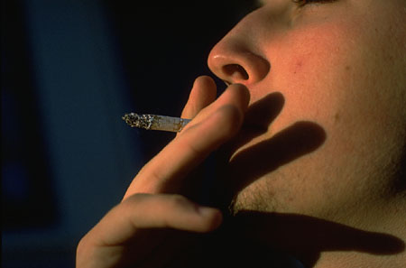
Cannabis: Basic facts (4)
Withdrawal Symptoms:
  Insomnia
  Restlessness
  Loss of appetite
  Irritability
  Sweating
  Tremors
  Nausea
  Diarrhea
Notes:
Instructions
Explain to participants that many people have believed that marijuana is not physically addictive. However, there appears to be a characteristic withdrawal profile indicating that physical dependence does actually occur.
Read the symptoms of cannabis withdrawal to your audience.
(Source: NIDA InfoFacts.)

Slide 33
Marijuana: Negative Effects on Behavior and Mental Health
Similar to alcohol/other drugs if misused (impairment)
Long term use has negative impact on learning and memory
Long term use reduces motivation (“amotivational syndrome”)
Associated with mental health problems
  Unclear if marijuana use is cause or effect
  Heavy use is highly associated with serious mental illness – particularly among those with high risk (e.g., family history)
SOURCES: Ben Amar, 2006; Bostwick, 2012; NIDA, 2012a, 2012b (reference list).
Notes:
INSTRUCTIONS
The purpose of this slide and the two slides that follow is to highlight that marijuana use can have serious negative effects. Introduce these slides by saying that people often say that marijuana is “harmless.” The information presented on these slides highlights that it is not at all a “harmless” drug.
KEY POINTS
Marijuana use can have very negative effects on behavior and mental health. Since marijuana is a psychoactive drug, it causes significant impairment, just like alcohol and other drugs. This means that when experiencing a marijuana “high” people are impaired, both physically and mentally. It is unsafe to drive, operate heavy machinery, or do other things that require concentration and physical coordination when under the influence of marijuana. Long-term marijuana use has a negative impact on learning and memory. Long-term marijuana use also causes amotivational syndrome, as it makes regular users less motivated to do things. Marijuana use is also associated with mental health problems and mental illness, particularly mood disorders. It is unclear if marijuana is what causes these problems, or if people who have mood disorders are more likely to use marijuana to self-medicate. Research also shows that heavy marijuana use is associated with serious mental illness, particularly among people who are at risk for serious mental illness because of family history.
Additional Information for the Trainer(s)
Serious mental illness differs from “mental illness” in general in that it lasts longer and is more disabling, often preventing people from working or functioning in their day to day lives. Among individuals who meet diagnostic criteria for marijuana abuse, 36% have had a mood disorder in their life, and 25% have had an anxiety disorder in their life. Among individuals who meet diagnostic criteria for marijuana dependence, 60.5% have had a mood disorder in their life, and 48.5% have had an anxiety disorder in their lifetime. Overall, marijuana dependence increases the odds of a co-occurring mood disorder by 6.5 times, and of an anxiety disorder by 4.6 times. Further, there is a significant gender difference with regard to major depression, with marijuana dependence increasing the odds for men by 4.6 times and 7.2 times for women.
REFERENCE:
Conway, K.P., Compton, W., Stinson, F.S., & Grant, B.F. (2006). Lifetime comorbidity of DSM-IV mood and anxiety disorders and specific drug use disorders: Results from the National Epidemiological survey on Alcohol and Related Conditions. Journal of Clinical Psychiatry, 67, 247-257.

Slide 34
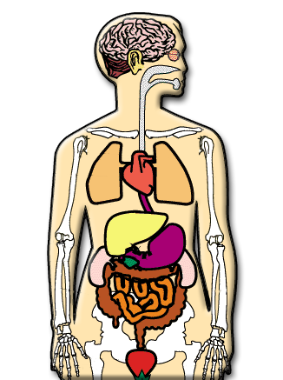
Long-term effects of cannabis use
Increase in activation of stress-response system
Changes in neurotransmitter levels
Psychosis in vulnerable individuals
Increased risk for cancer, especially lung, head, and neck
Respiratory illnesses (cough, phlegm) and lung infections
Immune system dysfunction
Harm to a fetus during pregnancy
Notes:
Instructions
Read the long-term effects of cannabis use to your audience.
Point to the areas of the body that are affected by the use of this drug.
Additional Information for the Trainer
Research findings on long-term marijuana abuse indicate some changes in the brain similar to those seen after long-term abuse of other major drugs. For example, cannabinoid (THC or synthetic forms of THC) withdrawal in chronically exposed animals leads to an increase in the activation of the stress-response system and changes in the activity of nerve cells containing dopamine. Dopamine neurons are involved in the regulation of motivation and reward, and are directly or indirectly affected by all drugs of abuse.
(Source: NIDA InfoFacts.)

Slide 35
Neurologic Impact of Marijuana in Adults
Administered neuropsychological tests to 63 current heavy cannabis users who had smoked cannabis at least 5,000 times in their lives and to 72 control subjects who had smoked no more than 50 times in their lives.
Differences between the groups after 7 days of supervised abstinence were reported. However, no deficits were found after 28 days abstinence, after adjusting for various potentially confounding variables.
Suggest that cognitive deficits associated with long-term cannabis use are reversible and related to recent cannabis exposure.
Pope HG, et al. (2001). Arch Gen Psychiatry. 2001 Oct; 58(10):909-15.

Slide 36
Acute Effects of Cannabis in Intoxication Phase
Cognition
  Difficulty with complex tasks
  Difficulty learning
Executive Function
  Impaired decision making
  Increased risky behavior – STDs, HIV
Mood
  Anxiety – panic attacks
  Psychosis - paranoia
SOURCE: Dr. Susan Weiss, NIDA, August 2017 National Cannabis Summit Keynote, Denver, CO.

Slide 37
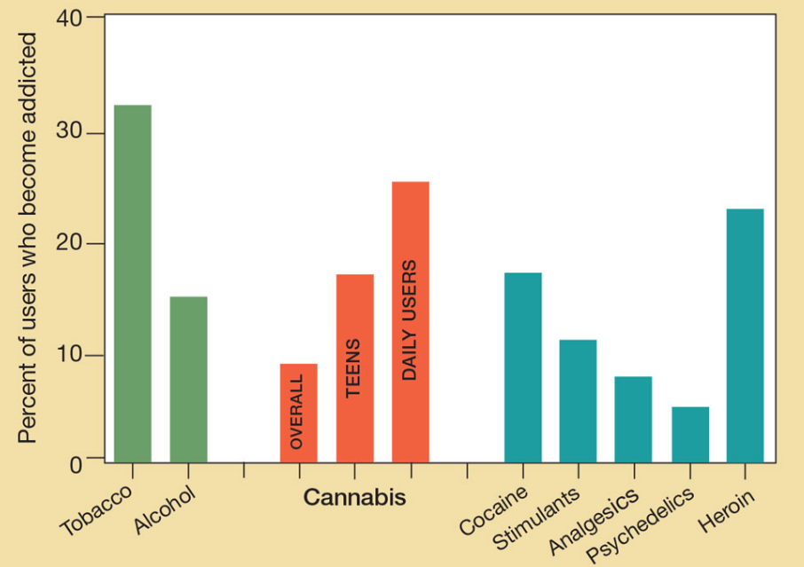
Comparison of Addictive Potential by Drug Type
SOURCE: Gilman, 2015.
Notes:
Read Gilman article for more notes
http://www.psychiatrictimes.com/special-reports/cannabis-use-young-adults-challenges-during-transition-adulthood
Although marijuana can be addictive, a smaller proportion of people who try marijuana ever become dependent on it when compared to other substances listed on the table. A major reason that such a low percentage of people who try marijuana ever become addicted is that such a large number of people try the drug but are not heavy users. This statistic should not be read to indicate that marijuana is not addictive; just that many people who try the drug never become heavy users. Risk of addiction: this number increases among those who start young (to about 17 percent, or 1 in 6) and among daily users (to 25–50 percent).
Nicotine 32%
Heroin 23%
Cocaine 17%
Alcohol 15%
Cananbis 9%
REFERENCE
Gilman, J. (2015). Cannabis use in young adults: Challenges during the transition to adulthood. Psychiatric Times, 32(12), xx-xx.

Slide 38
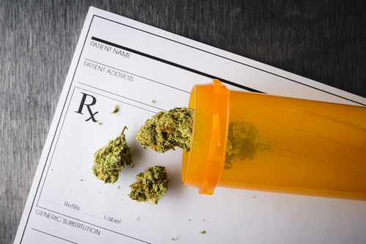
Can Marijuana be Used as a Medicine?
In some states, yes.
Chemicals in the marijuana plant are used to treat some illnesses or medical symptoms.
The unprocessed marijuana plant is not recognized by the
federal government or
approved as a medicine
by the FDA.
Notes:
Fotolia image to purchase: File: #76578537

Slide 39
Can people become addicted to marijuana?
Yes.
Research confirms that you can become addicted to marijuana.
Stay tuned for more…
Notes:
NIDA Tips for Teens

Slide 40
How is Marijuana Used?
SMOKED | VAPORIZED | EATEN/DRUNK
Smoked in a pipe, bowl, cigarette | Inhaled through machine that converts active compounds into inhalable form | Consumed as ingredient in baked goods, candies, sodas
Rapid effects | Rapid effects | Takes time to reach brain, so effects are delayed
Burning marijuana releases toxins that can cause pulmonary problems | Does not release toxins that cause pulmonary problems | Does not release toxins that cause pulmonary problems
SOURCE: University of Utah, 2018.
Notes:
The purpose of this slide is to review the three main ways that marijuana can be consumed. The most common way that marijuana is used is by being smoked, either in a pipe, a bowl, or rolled into a cigarette (also known as a “joint”). When smoked, marijuana has rapid effects. The process of burning marijuana, however, releases toxins from the plant, and these can cause serious pulmonary problems. An alternative way to use marijuana is with a vaporizer, which is a machine that converts the active compounds from marijuana into inhalable form, but without burning them. This allows users to have rapid effects like when they smoke, but without inhaling the toxins that are produced in the process of burning marijuana. A third method to consume marijuana is by eating or drinking it. In this form, marijuana is an ingredient in baked goods, candies, or sodas. When consumed orally within food or drink, marijuana takes time to reach the brain, since it first goes through the digestive system. When eaten, it does not release the toxins that cause pulmonary problems that are produced when marijuana is smoked.
Smoking – 50% THC
Edibles – 10 mg of THC in 1 dose
Vaporizers – 70% THC, dependent on device
Dabbing – up to 40-60% THC (losses due to burn method)
SOURCE: Win Turner, NCS 2017.
REFERENCE:
University of Utah, Genetic Science Learning Center. (2018). Cannabis in the Clinic? The Medical Marijuana Debate. Retrieved from http://learn.genetics.utah.edu/content/addiction/cannabis/ on 2018, May 18.

Slide 41
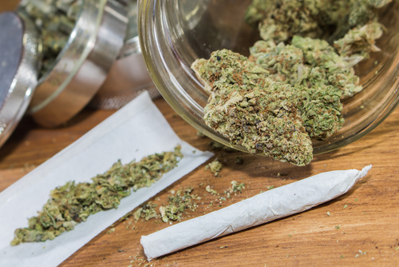
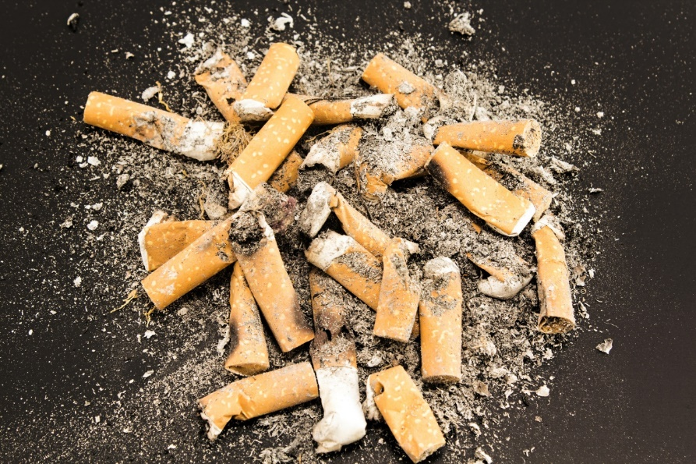
Is smoking marijuana less dangerous than smoking cigarettes?
No.
Smoking five marijuana
joints a day can be as harmful
as smoking 20 cigarettes a day
Notes:
NIDA Tips for Teens, Revised 2014.
https://store.samhsa.gov/shin/content//PHD641/PHD641.pdf
Fotolia image to purchase (joint): File: #150310400; Fotolia purchased image, 2016 (cigarettes).

Slide 42
What is the Cardiac Risk of Using Marijuana?
Tachycardia (rapid heartbeat)
•Increased blood pressure
•Atrial fibrillation (arrhythmic heart rate)
•Myocardial infarction (heart attack)
•Increased risk of death after heart attack
•Cardiac arrest
•Stroke, transient ischemic attack
SOURCE: Thomas et al., 2014.
Notes:
Need notes
REFERENCE:
Thomas, G., Kloner, R.A., & Rezkalla, S. (2014). Adverse cardiovascular, cerebrovascular, and peripheral vascular effects of marijuana inhalation: What cardiologists need to know. American Journal of Cardiology, 113, 187-190.

Slide 43
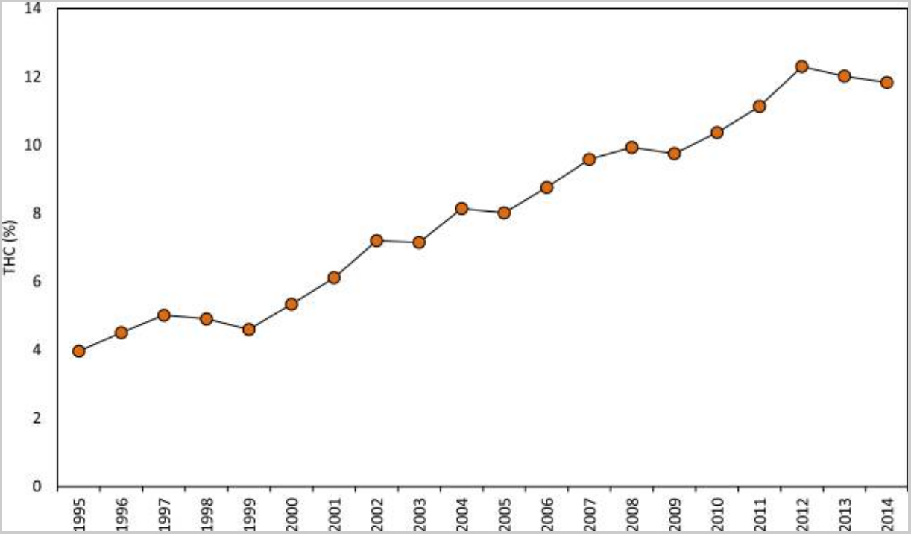
“It’s not your dad’s ‘pot’ anymore”
Average THC content increased 200% from 1995 to 2014
  Marijuana growers have worked to make the drug as potent as possible.
  In 1960s-70s average THC concentrations were 1-2%. Today, they can be as high as 20%
SOURCES: ElSohly et al., 2016.
Notes:
This slide highlights the notion that growers have developed methods to make marijuana much more potent than it was twenty or thirty years ago. In a recent article by ElSohly and colleagues, they present data on the concentration of cannabinoids in illicit cannabis samples seized by the Drug Enforcement Administration. From 1995 to 2014, the amount of THC in seized samples increased from 4% to 12%, a 200% increase.
Because the potency of marijuana has been increasing, it is increasingly likely that its use may have more severe negative consequences or side effects. This also highlights that common perceptions that marijuana is “harmless” are based on ideas from 30-40 years ago, when the drug was not nearly as potent as it is today. Since the drug has become much more powerful, it is more important to be aware of marijuana’s potential dangers today than in the past.
REFERENCE:
ElSohly, M.A., Mehmedic, Z., Foster, S., Gon, C., Chandra, S., & Church, J.C. (2016). Changes in cannabis potency over the last two decades (1995-2014) – Analysis of current data in the United States. Biol Psychiatry, 79(7), 613-619.

Slide 44
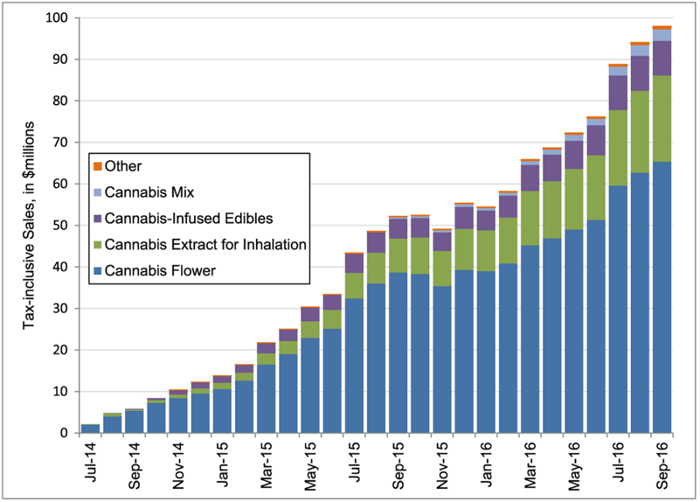
Potential Trend Under Legalization:
More Strong Stuff (Washington State)
  Sales grew dramatically
  Plant still accounts for 2/3 of expenditure, but market share declined 22.4%
  Extracts’ market share grew dramatically (145.8%)
  Market share of edibles grew, but not statistically significant
  Products sold on legal market are highly potent
    Cannabis plant: THC 20.6%
    Extracts: THC 68.7%
SOURCE: Smart et al., 2017.
Notes:
The purpose of this slide is to review the three main ways that marijuana can be consumed. The most common way that marijuana is used is by being smoked, either in a pipe, a bowl, or rolled into a cigarette (also known as a “joint”). When smoked, marijuana has rapid effects. The process of burning marijuana, however, releases toxins from the plant, and these can cause serious pulmonary problems. An alternative way to use marijuana is with a vaporizer, which is a machine that converts the active compounds from marijuana into inhalable form, but without burning them. This allows users to have rapid effects like when they smoke, but without inhaling the toxins that are produced in the process of burning marijuana. A third method to consume marijuana is by eating or drinking it. In this form, marijuana is an ingredient in baked goods, candies, or sodas. When consumed orally within food or drink, marijuana takes time to reach the brain, since it first goes through the digestive system. When eaten, it does not release the toxins that cause pulmonary problems that are produced when marijuana is smoked.
REFERENCE:
Smart, R., Caulkins, J.P., Kilmer, B., Davenport, S., & Midgette, G. (2017). Variation in cannabis potency and prices in a newly legal market: Evidence from 30 million cannabis sales in Washington state. Addiction, 112, 2167-2177.

Slide 45
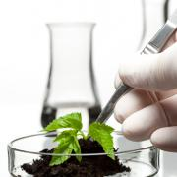
What Are the Products
That People Are Using
Notes:
TRANSITION SLIDE
Part 2 of the training focuses on the use of marijuana as a medicine and the legal questions surrounding medical marijuana.
Image Credit: Purchased image, 2012.

Slide 46
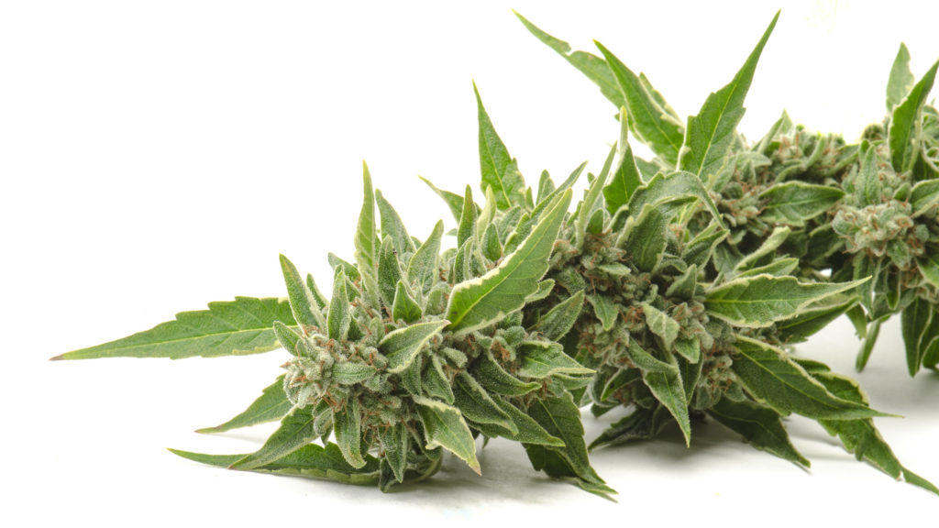
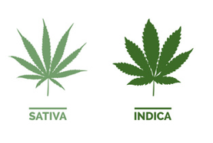
The Plant
1990s approx. 2-4% THC
Today approx. 12-15% THC
Today about 5 mg THC/puff
Feel effects almost instantly

Slide 47
Indica vs. Sativa
What’s the Difference?
 | Sativa | Indica
Shape and Color of Leaves | Long, thin leaves Light color | Wide, broad leaves Deep color
Growing Pattern | 12-16 week flowering time 8-15 feet tall Airy, tall buds | 6-8 week flowering time 2-6 feet tall Dense, plump buds
Type of High | Mind/High (day time) | Body/Stoned (night time)
Effects | Euphoria Creative Alert Energetic Cheerful Sociable | “Couch-lock” Carefree Calm Relaxed Sleepy Mellow
39
Notes:
Fotoloia image to download: File: #200502031
Sativa tends to provide more invigorating, uplifting cerebral effects that pair well with physical activity, social gatherings, and creative projects; and is best suited for day use. Indica tends to result in relaxing and calming effects; a body buzz (couch-lock); best suited for night use. Hybrids are cross-bred strains of cannabis that have both indica and sativa genetics. They can take after either parent or be a blend of both.
https://www.leafscience.com/2017/10/16/indica-vs-sativa-whats-difference/
Image credit: Fotolia purchased image, 2018.

Slide 48
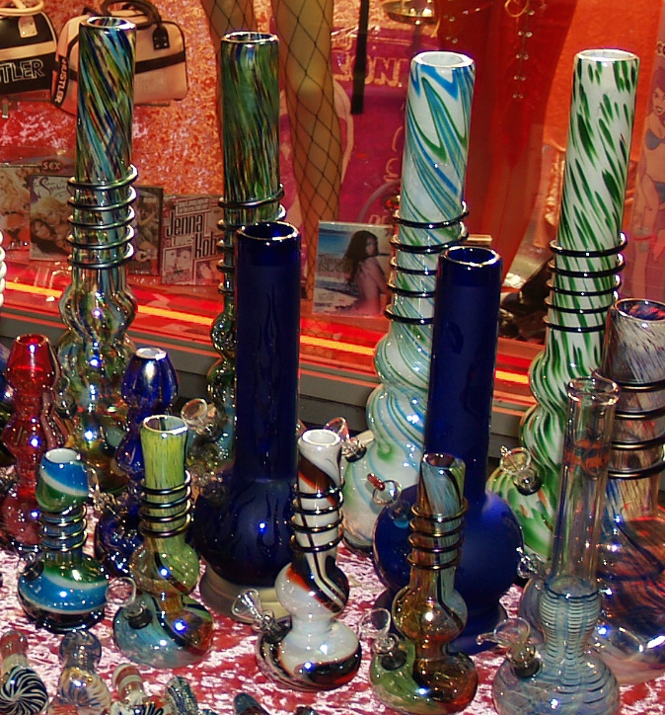
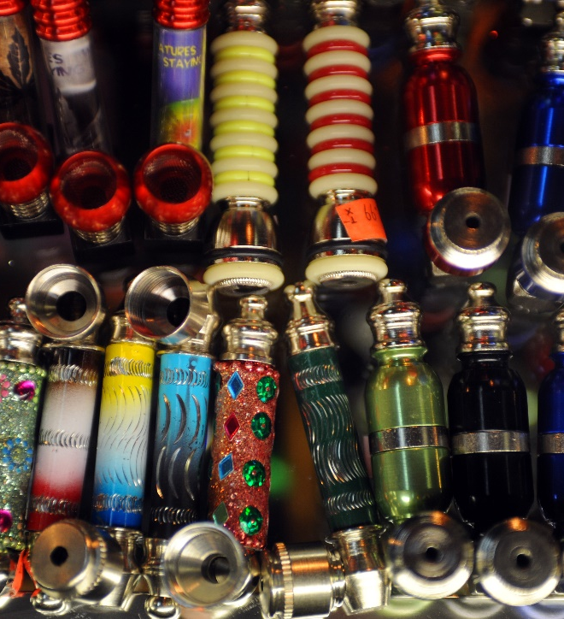
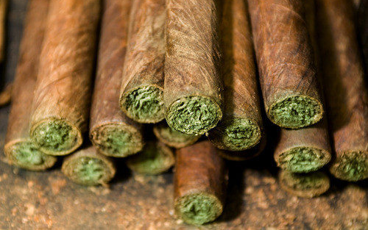
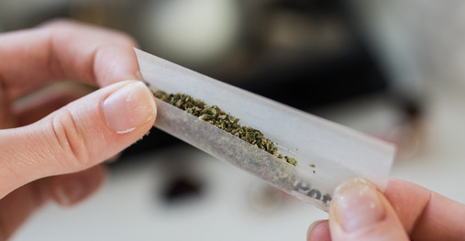
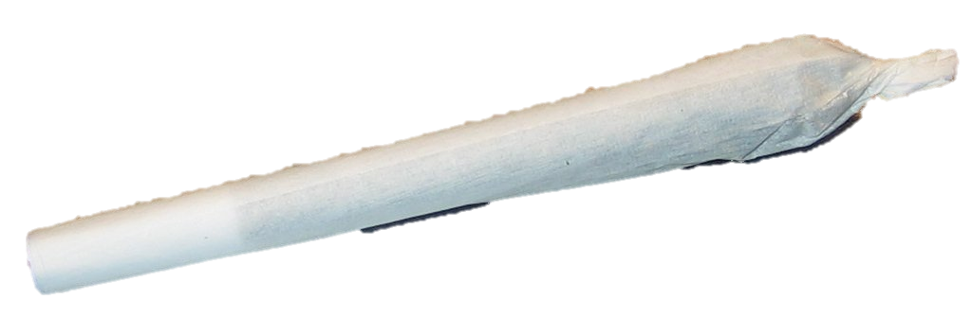
Use Devices for Smoking Flowers
Water Pipe/Bong
Pipe
Joint
Blunt

Slide 49
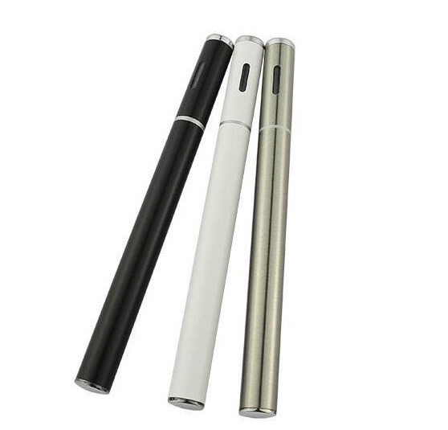
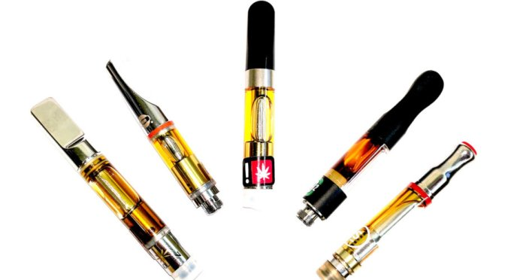
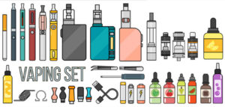
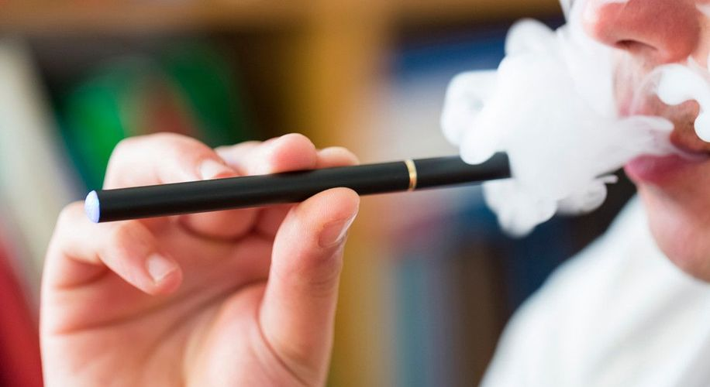
Cannabis Vaping

Slide 50
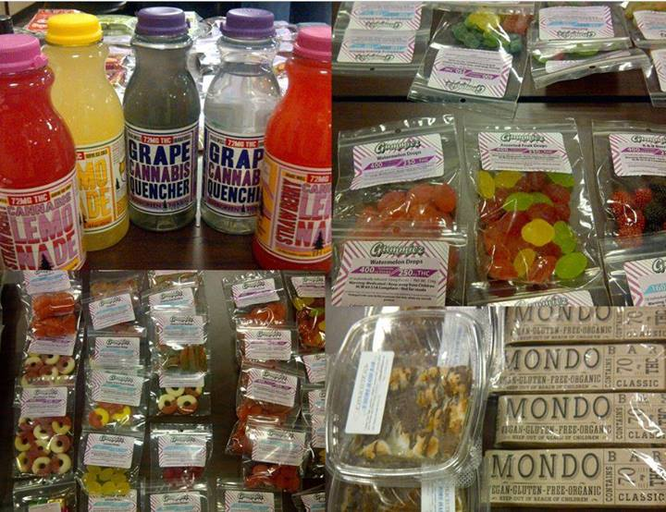
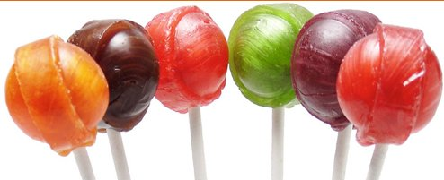
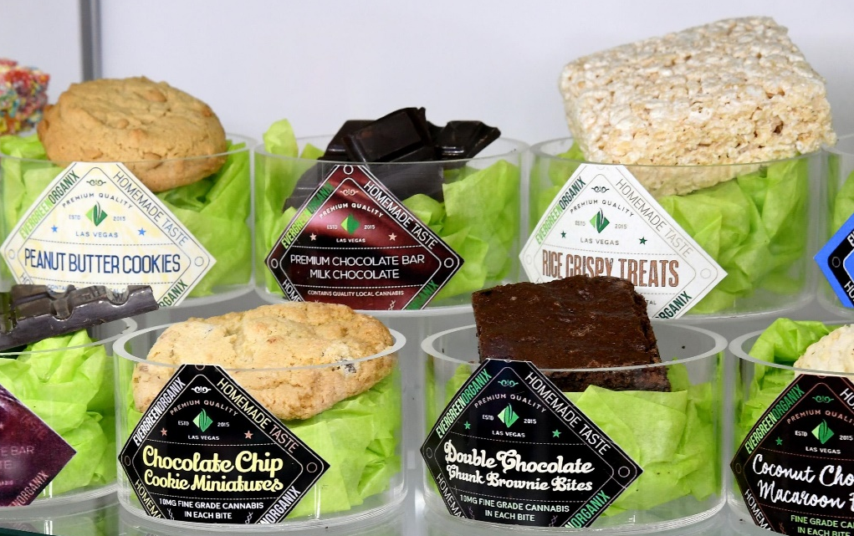
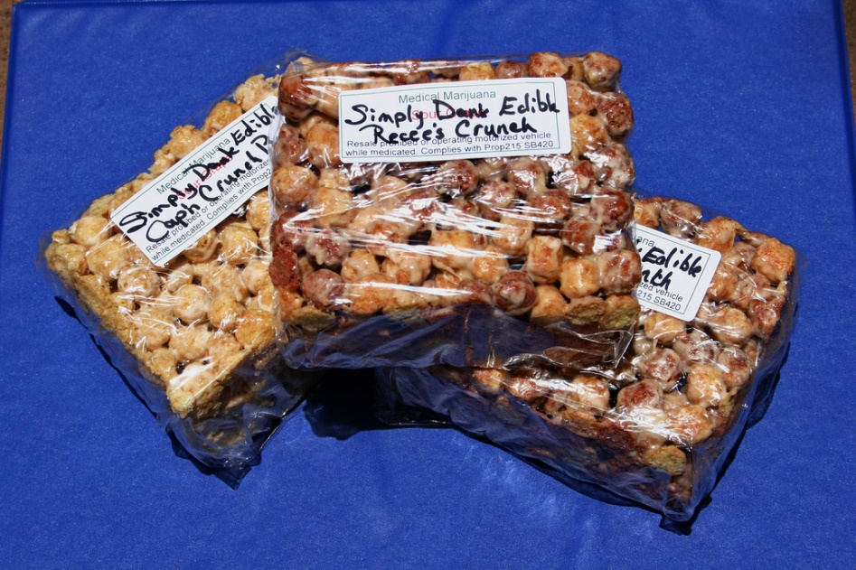
Cannabis Edibles
Notes:
TRANSITION SLIDE
Part 2 of the training focuses on the use of marijuana as a medicine and the legal questions surrounding medical marijuana.
Image Credit: Purchased image, 2012.

Slide 51

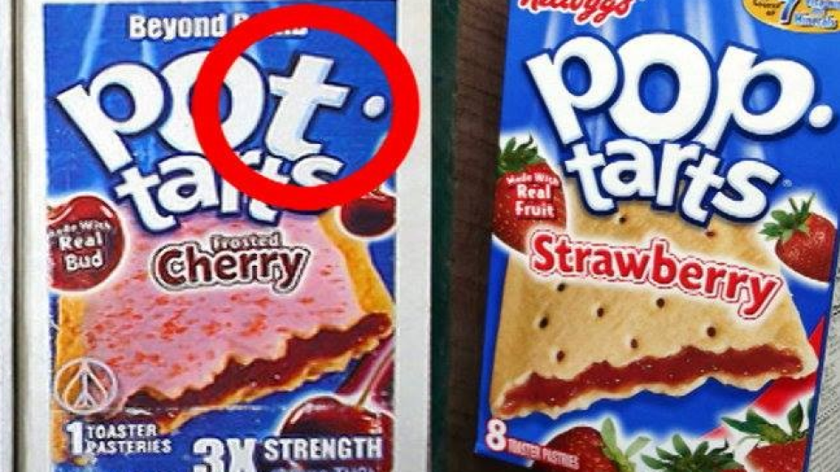
Cannabis Edibles
Cannabis plant as ingredient in food/drinks
About 10 mg THC per “serving”
Takes time to digest and feel high (30 minutes +)
Risk of overconsumption

Slide 52
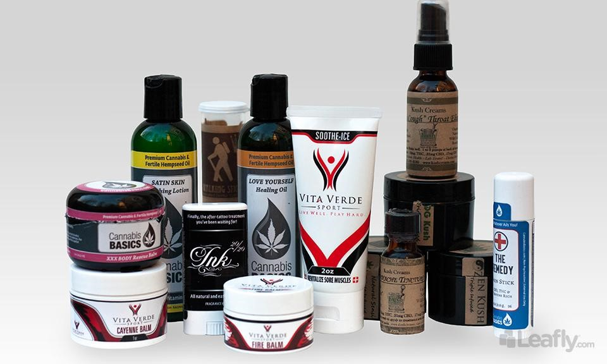
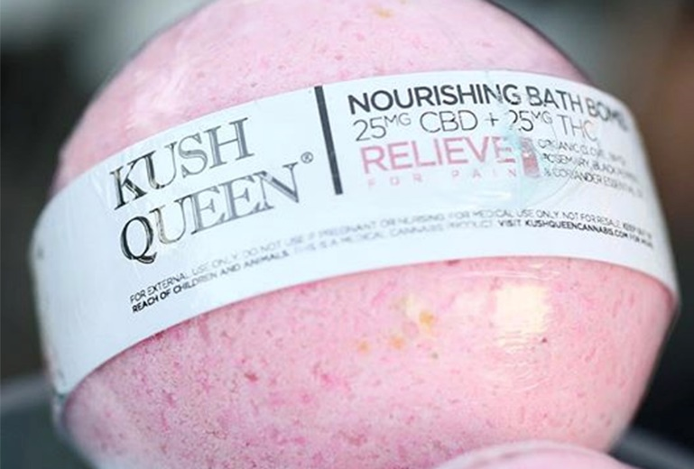
Cannabis Topicals
lotions/patches for pain relief and skin irritation, bath products, lip balm, or personal lubricants.
Very slow onset without the high

Slide 53
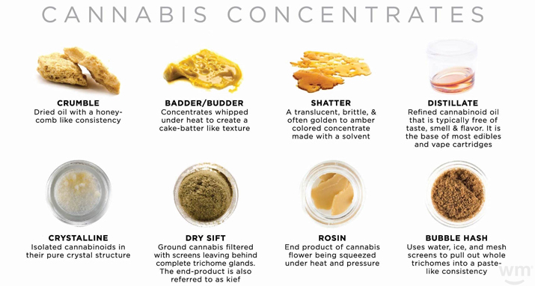
Consumed via smoking, vaporizing, or
heating and inhaling smoke
50-90% (or higher) THC

Slide 54
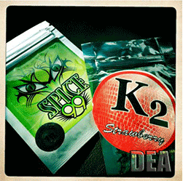
These are NOT marijuana
Synthetic cannabinoid users report some effects similar to those produced by marijuana:
  elevated mood
  relaxation
  altered perception
  symptoms of psychosis
Synthetic cannabinoids can also cause serious mental and physical health problems including:
  rapid heart rate
  vomiting
  violent behavior
  suicidal thoughts
Synthetic Cannabinoids: Spice, K2, etc.
Not for human consumption

Slide 55
Summary
The cannabis of today is not the pot of yesterday.
  Stronger
  Available in more forms
  Legal (ish) for people over 21 y.o.
The research is inconclusive about the impact on adolescents (although several studies point to enduring consequences
Providers need to know what and how people are using to facilitate discussions about use and its impact on functioning

Slide 56

For more information:
Thomas Freese: tfreese@mednet.ucla.edu
Pacific Southwest ATTC: http://www.psattc.org
PAETC Training calendar: http://www.HIVtrainingCDU.org
Notes:
Need to purchase Fotolia Image: File: #187800437
This concludes the presentation. Thank the participants for their time and address any last-minute questions about the content. Encourage participants to reach out to the Pacific Southwest ATTC or Pacific AETC, should they have questions or concerns following the training session.

